Slide 1
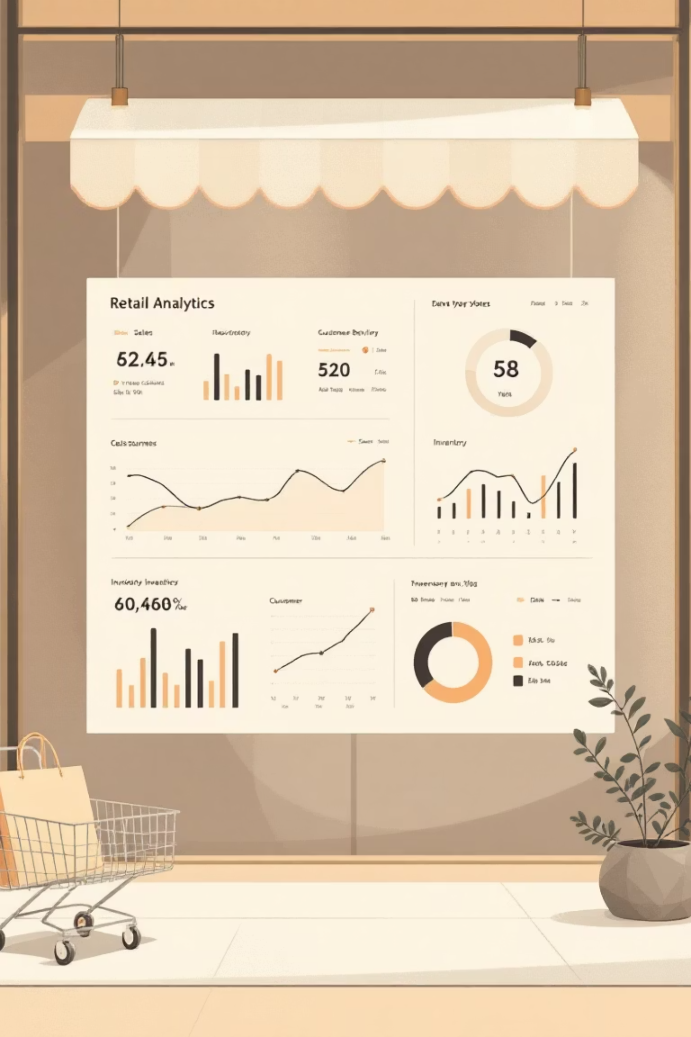
Customer Shopping Behavior Analysis
Analyzing 3,900 purchases to uncover insights into spending patterns, customer segments, and product preferences that drive strategic business decisions.

Slide 2
Dataset Overview
3,900
18
37
Total Purchases
Data Features
Missing Values
Transactions analyzed across all categories
Comprehensive customer and purchase attributes
Only in Review Rating column
Key features include customer demographics (age, gender, location, subscription status), purchase details (item, category, amount, season), and shopping behavior (discounts, previous purchases, review ratings, shipping type).

Slide 3




Data Preparation Process
Data Loading
Data Cleaning
Imported dataset using pandas and explored structure with df.info() and .describe()
Imputed missing Review Ratings using median by category; standardized column names to snake case
Feature Engineering
Database Integration
Created age_group and purchase_frequency_days columns; removed redundant promo_code_used field
Connected to PostgreSQL and loaded cleaned data for SQL analysis

Slide 4

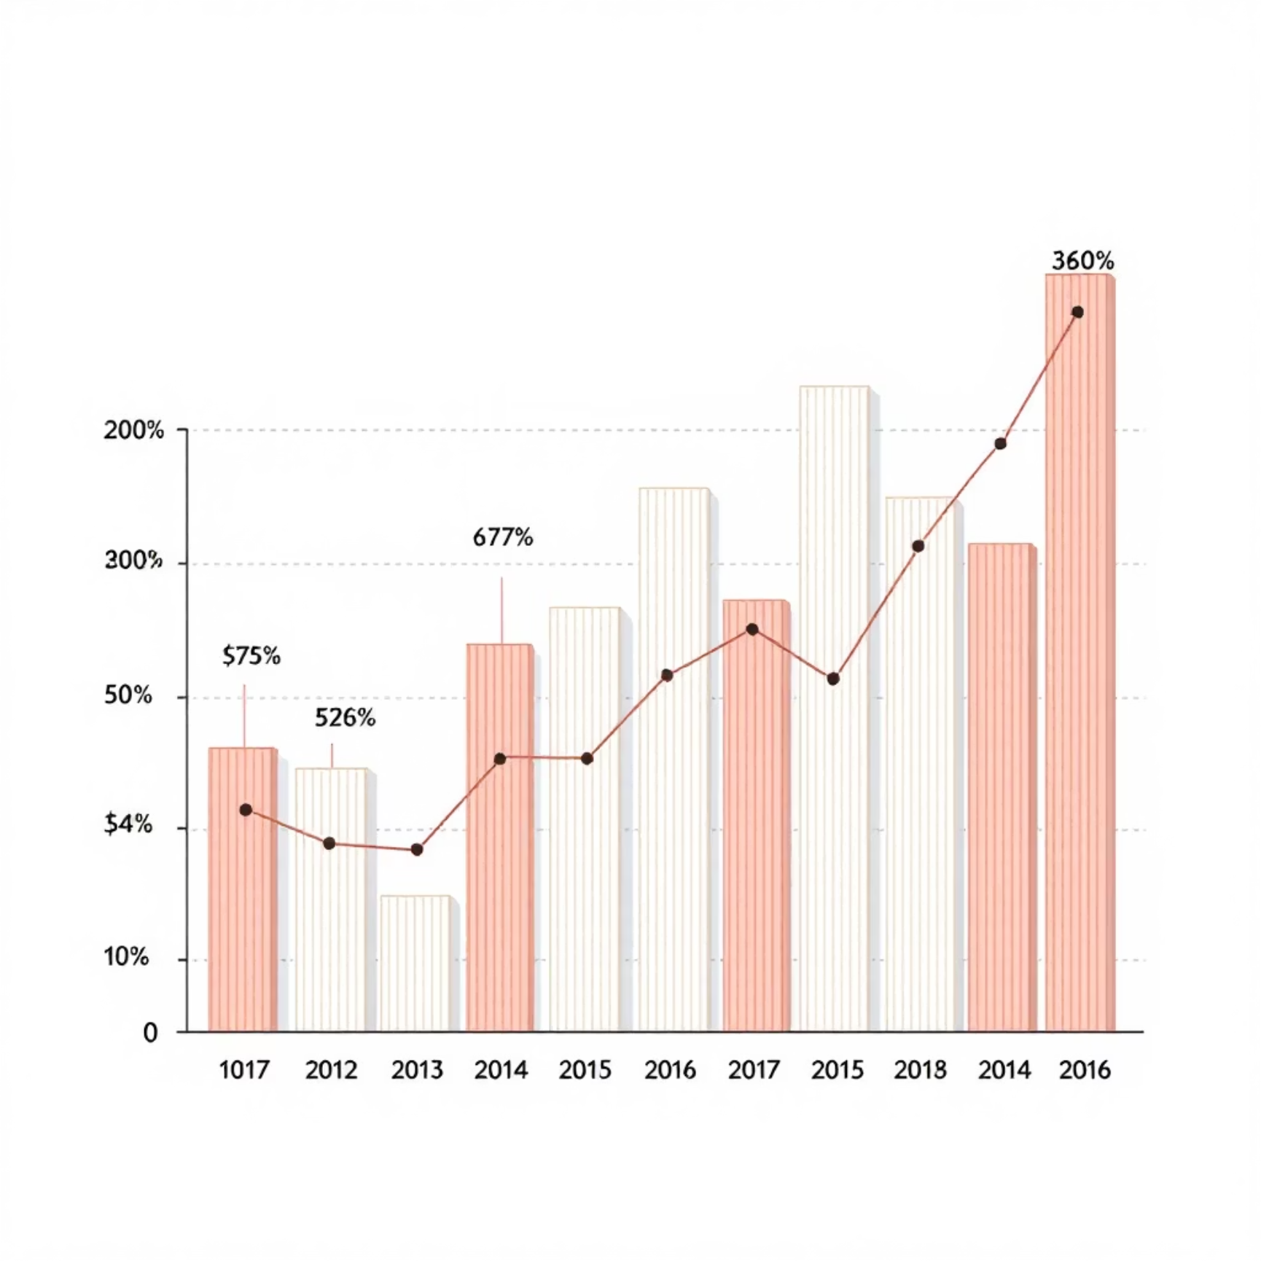
Revenue Insights
Gender Comparison
Age Group Performance
Male and female customers show comparable revenue generation, indicating balanced market appeal across genders.
Revenue contribution varies significantly by age group, with certain demographics driving higher total spend.

Slide 5

Discount & Spending Patterns
High-Spending Discount Users
Discount-Dependent Products
Identified customers who used discounts but still spent above average purchase amount
Found 5 products with highest percentage of discounted purchases
Strategic Implications
Balance promotional sales boosts with margin control for profitability

Slide 6

Product Performance
1
2
Top-Rated Products
Best-Sellers by Category
Identified products with highest average review ratings to guide marketing focus
Listed top 3 most purchased products within each category for inventory optimization
3
Customer Preferences
Analyzed patterns in size, color, and seasonal preferences across product lines

Slide 7

Shipping & Subscription Analysis
Shipping Type Impact
Express shipping users show different average purchase amounts compared to Standard shipping customers.
Subscription Behavior
68%
Subscribers demonstrate higher average spend and total revenue. Customers with >5 purchases show increased likelihood to subscribe.
Repeat buyers who subscribe

Slide 8




Customer Segmentation
Loyal
Returning
New
Classified customers into three segments based on purchase history. Loyal customers represent the highest value tier, followed by returning customers, with new customers forming the base for growth.

Slide 9
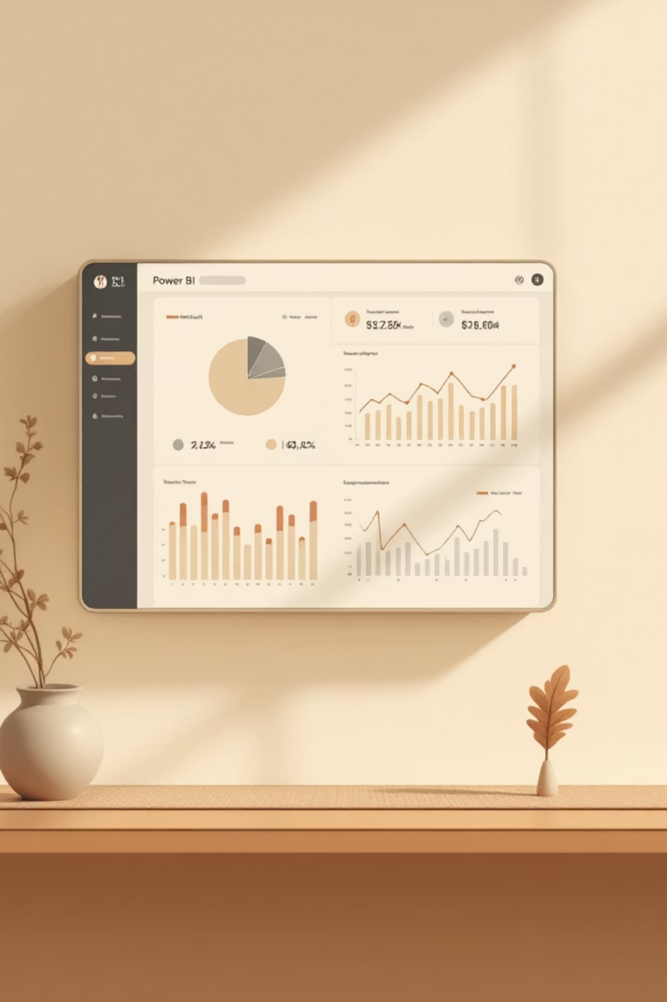
Interactive Dashboard
Built comprehensive Power BI dashboard presenting visual insights across all key metrics: revenue trends, customer segments, product performance, and behavioral patterns.

Slide 10
Strategic Recommendations
Boost Subscriptions
Loyalty Programs
Review Discount Policy
Promote exclusive benefits for subscribers to increase recurring revenue
Reward repeat buyers to move them into "Loyal" segment
Balance sales boosts with margin control for profitability
Targeted Marketing
Product Positioning
Focus on high-revenue age groups and express-shipping users
Highlight top-rated and best-selling products in campaigns

